Slide 1
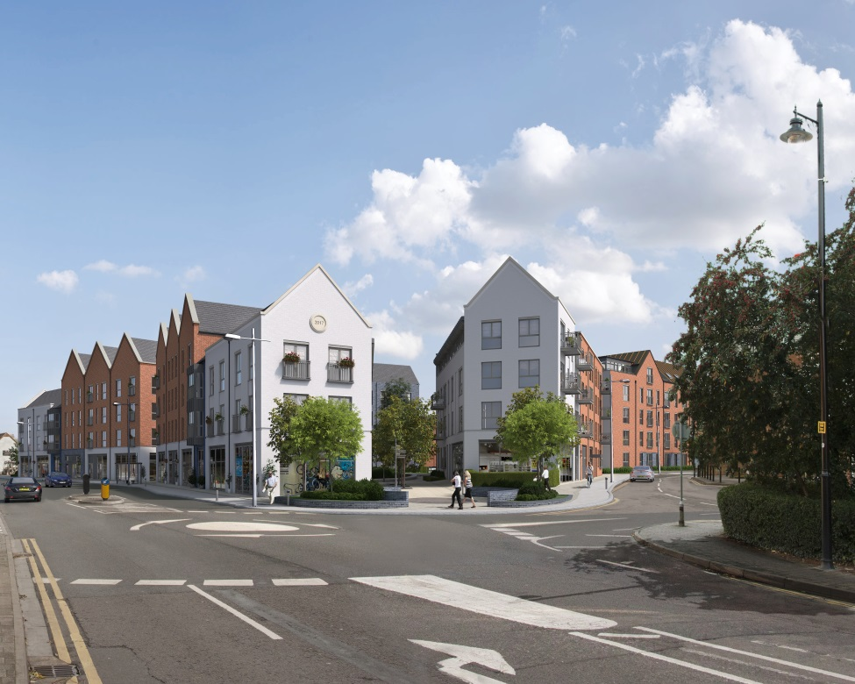
Market Street, Newbury
Chris Fletcher – Development Director
Rebecca Crow – Senior Development Manager
29th October 2018

Slide 2
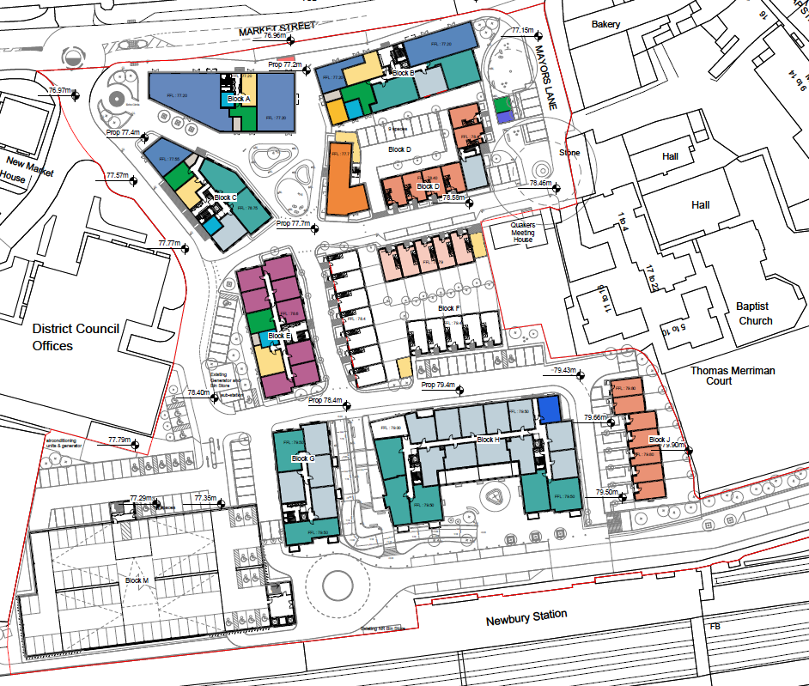
Scheme Summary
The scheme will provide:
232 new homes for rent
497 space multi storey car park for the Council and Network Rail
Nine new flexible use commercial units
Resident’s Hub
108 residents’ parking spaces
Five new parking spaces for the Friends’ Meeting House

Slide 3
Scheme Summary – public realm
The scheme will provide:
Pedestrian and cycle ramp providing a safe route between the station and town centre
New east and westbound bus stops
‘The Green’ area of open space
A new Station Square and improved Station Approach Road
A new Echo Circle on Market Street
Tree and shrub planting

Slide 4
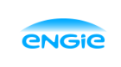
Programme and Start on Site
Main build contract for the delivery of the whole scheme has been signed with Engie.
Grainger will take possession of the site in December 2018, once the Council has opened the new bus station at The Wharf.
The site will be hoarded and secured in December with the construction works commencing in January 2019.

Slide 5
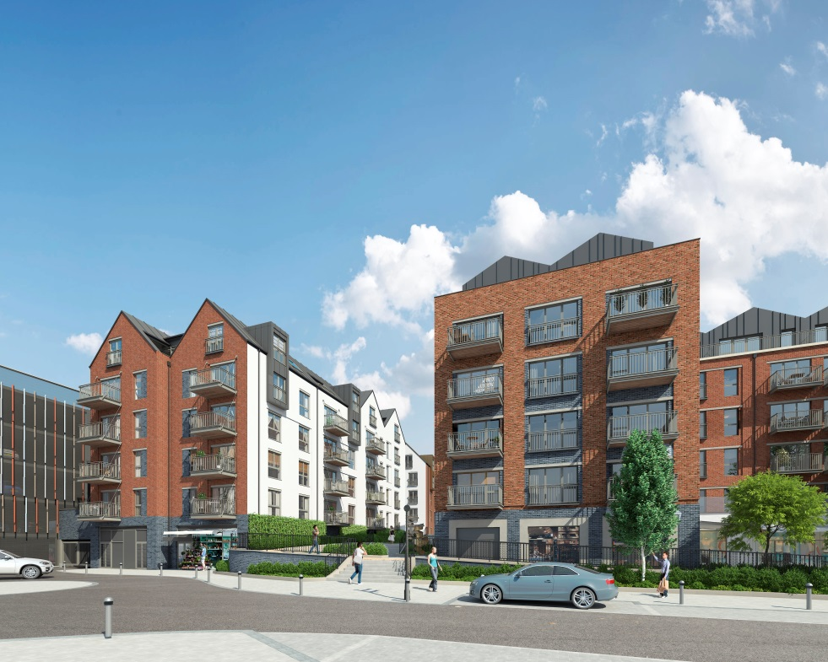
Construction Phasing Sequence

Slide 6
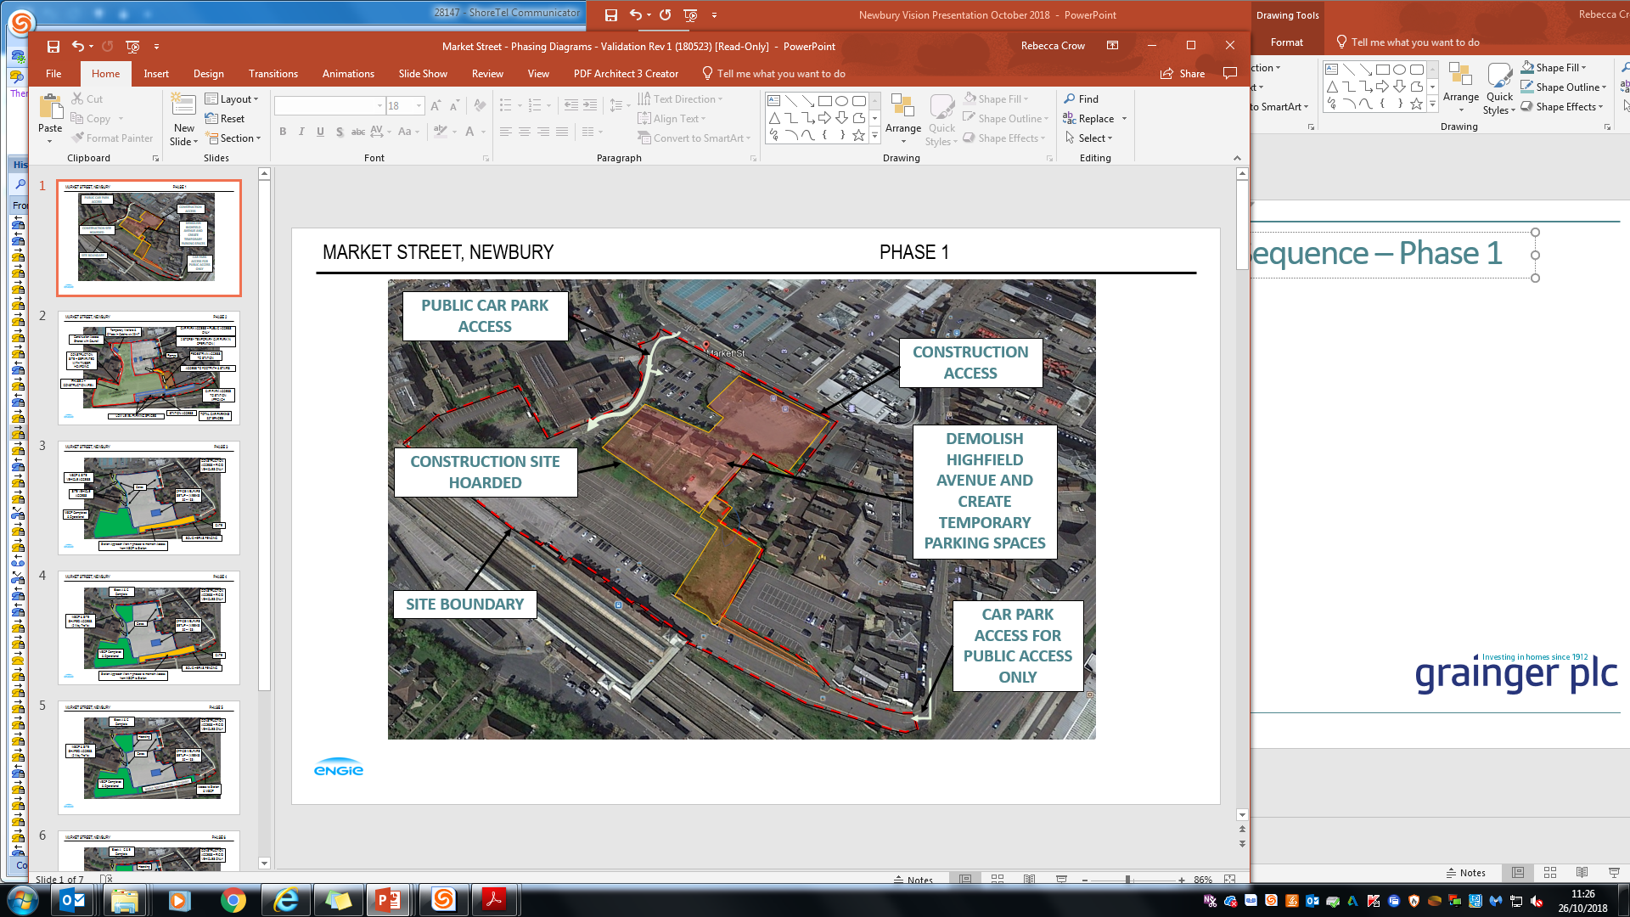
Phase 1 – demolition and temporary car park preparation
January 2019 to April 2019

Slide 7
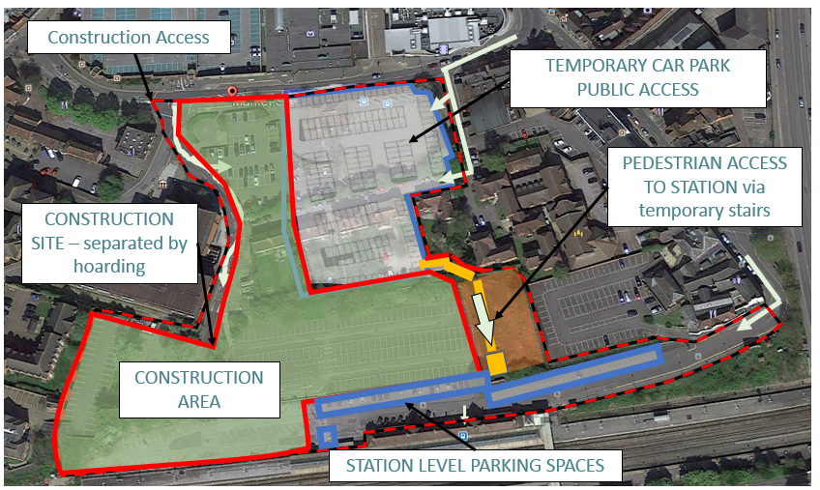
Phase 2 – construction of multi storey car park and first residential blocks
April 2019 to March 2020

Slide 8
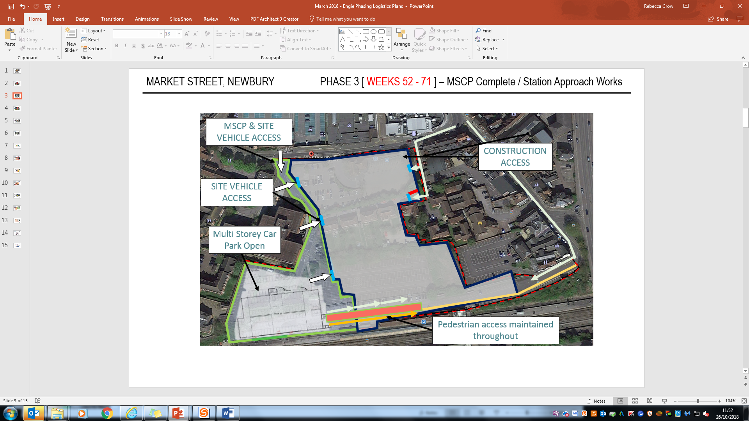
Phase 3 – construction of multi storey car park and first residential blocks
March 2020 – August 2020

Slide 9
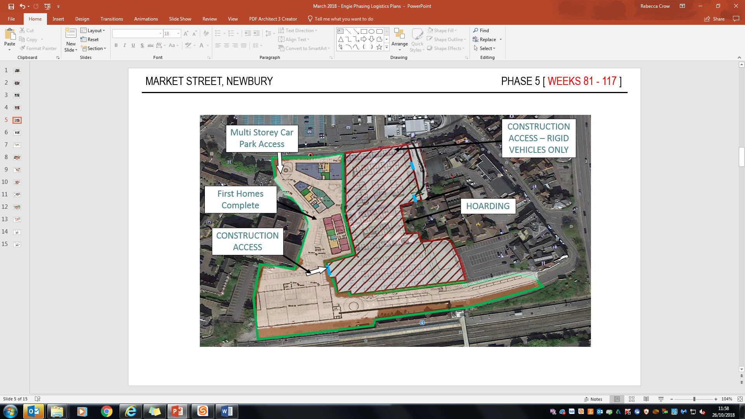
Phase 4 – completion of first new homes
August 2020 – January 2021

Slide 10
Phase 4 – completion of first new homes
August 2020 – January 2021

Slide 11
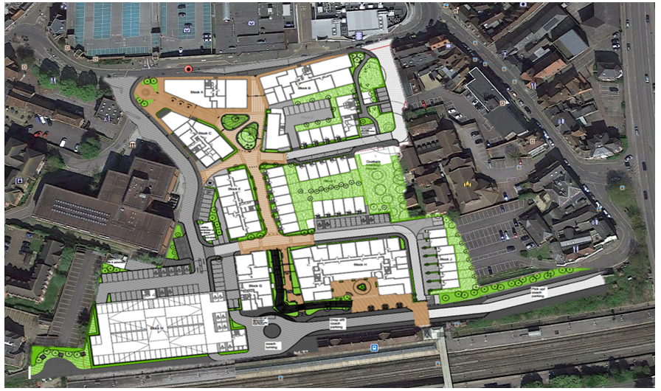
Phase 5 – completion of remaining homes and the Station Approach improvement works
August 2020 – July 2021
Station Approach Improvement Works (April 2020 – Sept 2020)

Slide 12
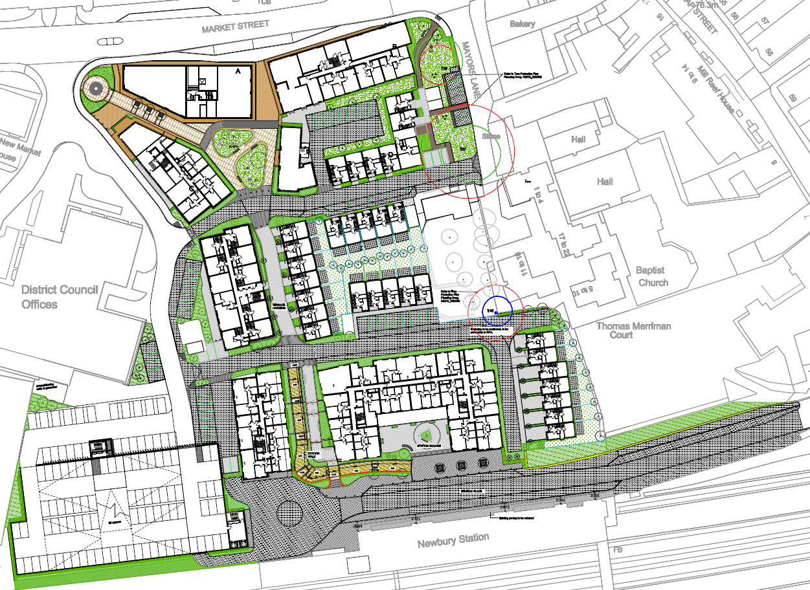
Scheme Completion – July 2021

Slide 13
The Completed Scheme – view from the Station
New station car park
Pedestrian and cyclist route to town centre

Slide 14
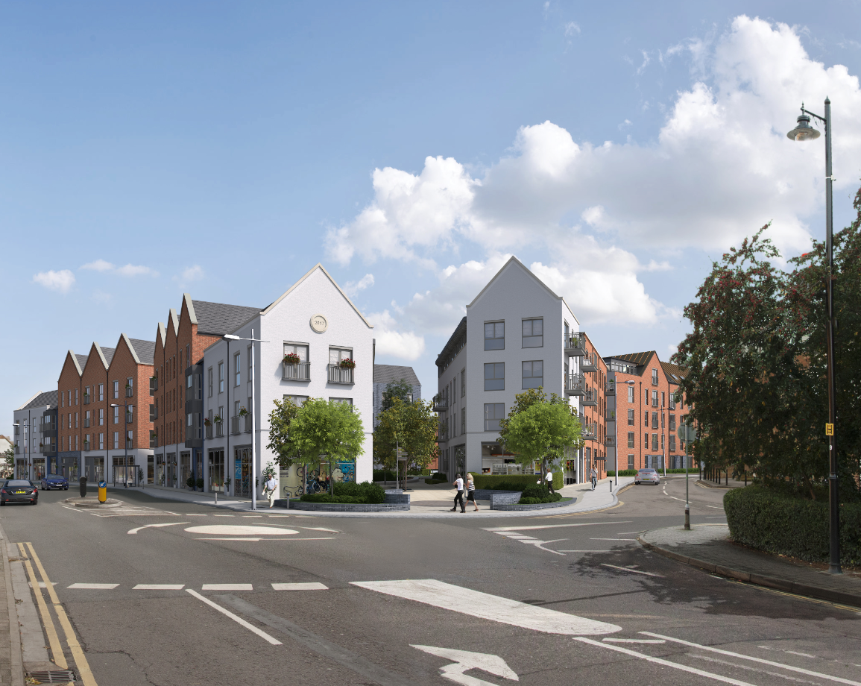
The Completed Scheme – view along Market Street
There will be nine new retail and office units of various sizes in the completed development, fronting both Market Street and the Station entrance.
Access to station car park
New retail and office space

Slide 15
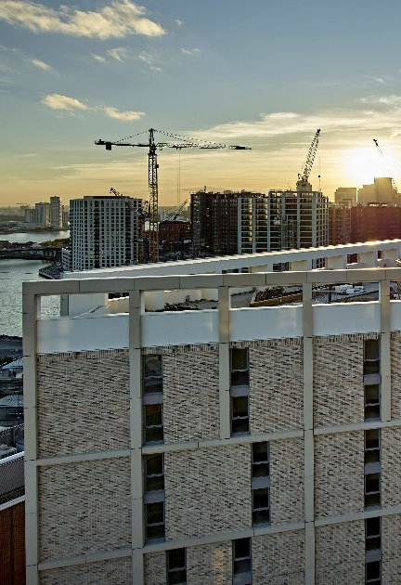

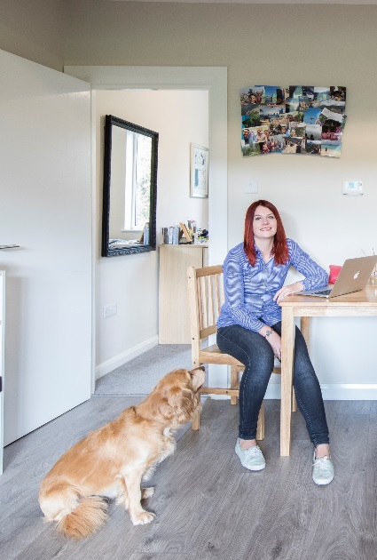
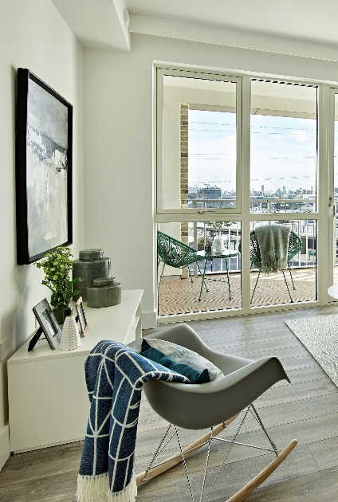
Grainger plc
A leader in the Private Rented Sector (PRS)
Chris Fletcher
Development Director

Slide 16

What is the PRS?
The Private Rented Sector (PRS) comprises residential accommodation privately owned and rented.
In 2017, 4.2 million UK households (20%) were in the PRS, a rapid rise from 11% in 2004.
The purpose-built PRS movement (known as Build to Rent), is a move from traditional buy-to-let landlords to a focus on larger scale development and institutional owners.
It is a definitively new product tailored towards a lifestyle built around amenity provision, community and services otherwise typically not provided in buy-to-let.

Slide 17
A fully integrated business model
Grainger plc
  Planning process
  Design
  Layout
  Specifications
  Delivery management
  Capital allocation
  Geographical targeting
  Investment management
  Acquisitions
  Asset recycling
  Valuation
Operate
Originate
Invest
Grow rents
Simplify
and focus
Build on our experience
  Lettings
  On boarding
  Customer experience
  Technology
  Management efficiencies
  Repairs & maintenance

Slide 18
The UK’s leading national operating platform
Asset managers
Portfolio managers
Technology team
Asset design team
Central operations
Mobile Property managers
Reliable repairs
service
Grainger office
Asset cluster

Slide 19
17 PRS projects underway
Originate
Invest
Operate
Forward Funding scheme
Direct Development – On Site
Direct Development – In planning / pre-site
Yorkshire Post, Leeds
Clippers Quay, Salford
Eccy Village, Sheffield
Gore Street, Manchester
Silbury Blvd, Milton Keynes
Gilders Yard, Birmingham
YMCA, Milton Keynes
Pontoon Dock, London
Finzels Reach, Bristol
Waterloo, Lambeth
Newbury, West Berks
Seven Sisters, Haringey
Besson Street, Lewisham
Berewood, Hampshire
RBKC, London
East Street, Southampton
Wellesley, Hampshire

Slide 20
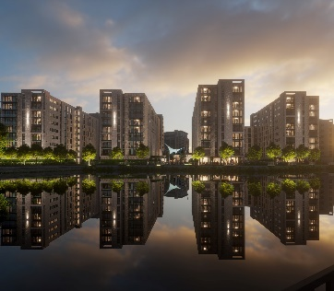
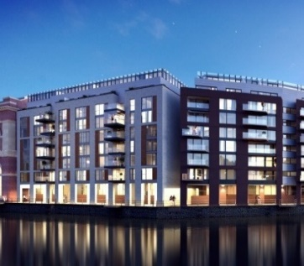
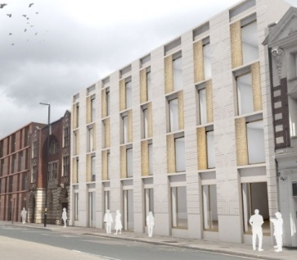
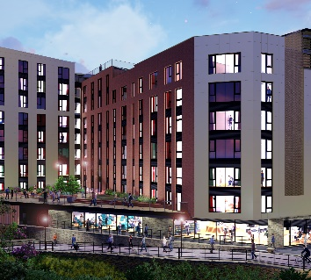
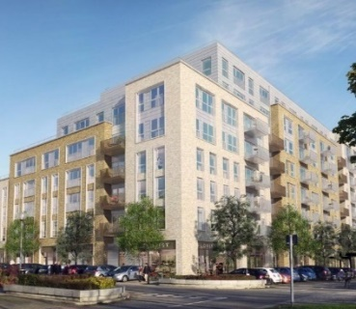
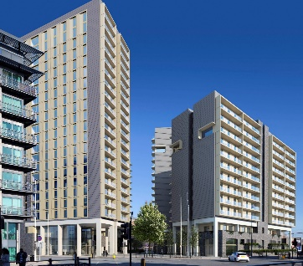
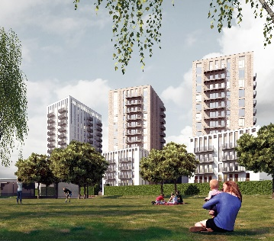
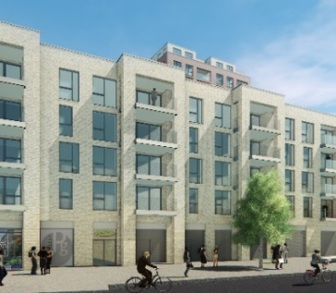
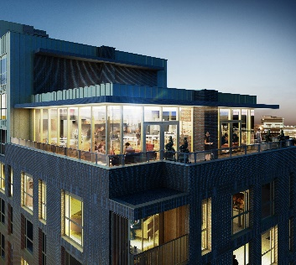
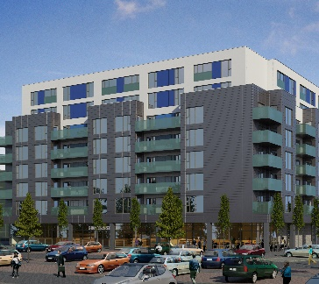
Forward funding schemes in construction
10 schemes, 2,586 units
2019
Clippers Quay
Manchester
614 units
Finzels Reach
Bristol
194 units
Gilder’s Yard
Birmingham
156 units
Eccy Village
Sheffield
237 units
Silbury Blvd Milton Keynes
139 units
2020
Gore Street
Manchester
375 units
Pontoon Dock London
236 units
East Street Southampton
132 units
Yorkshire Post
Leeds
242 units
2021
YMCA
Milton Keynes
261 units

Slide 21
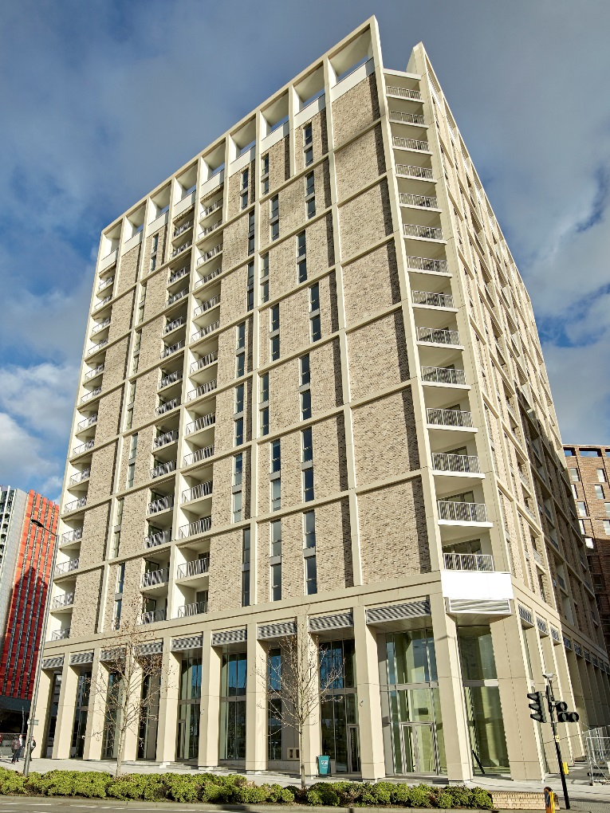
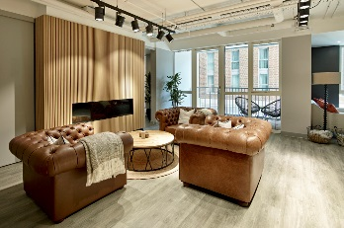
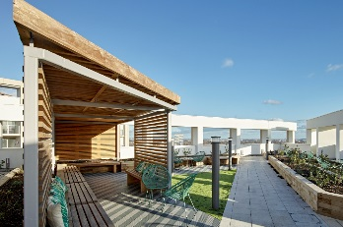
Case study
Argo Apartments, Canning Town, London
Apartments | 134
Investment via GRIP REIT (25% share) | £33m
100% let in… | …5 months | 42% 3yr lease
28
Average
age

Slide 22
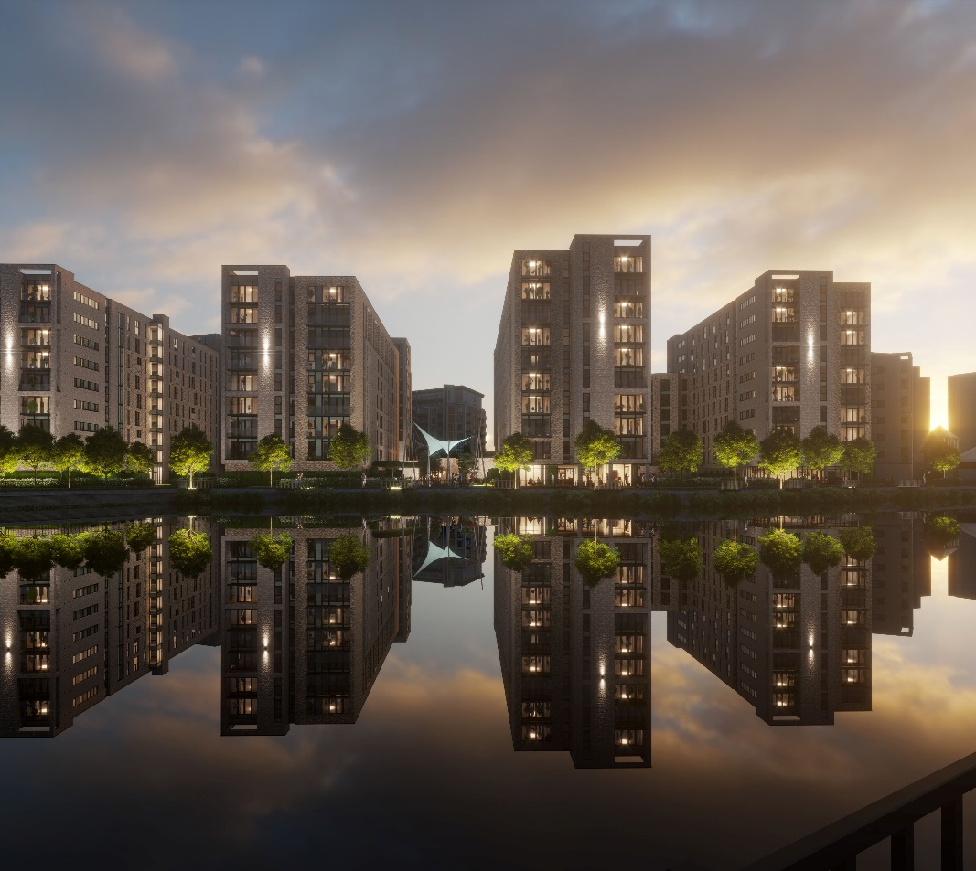
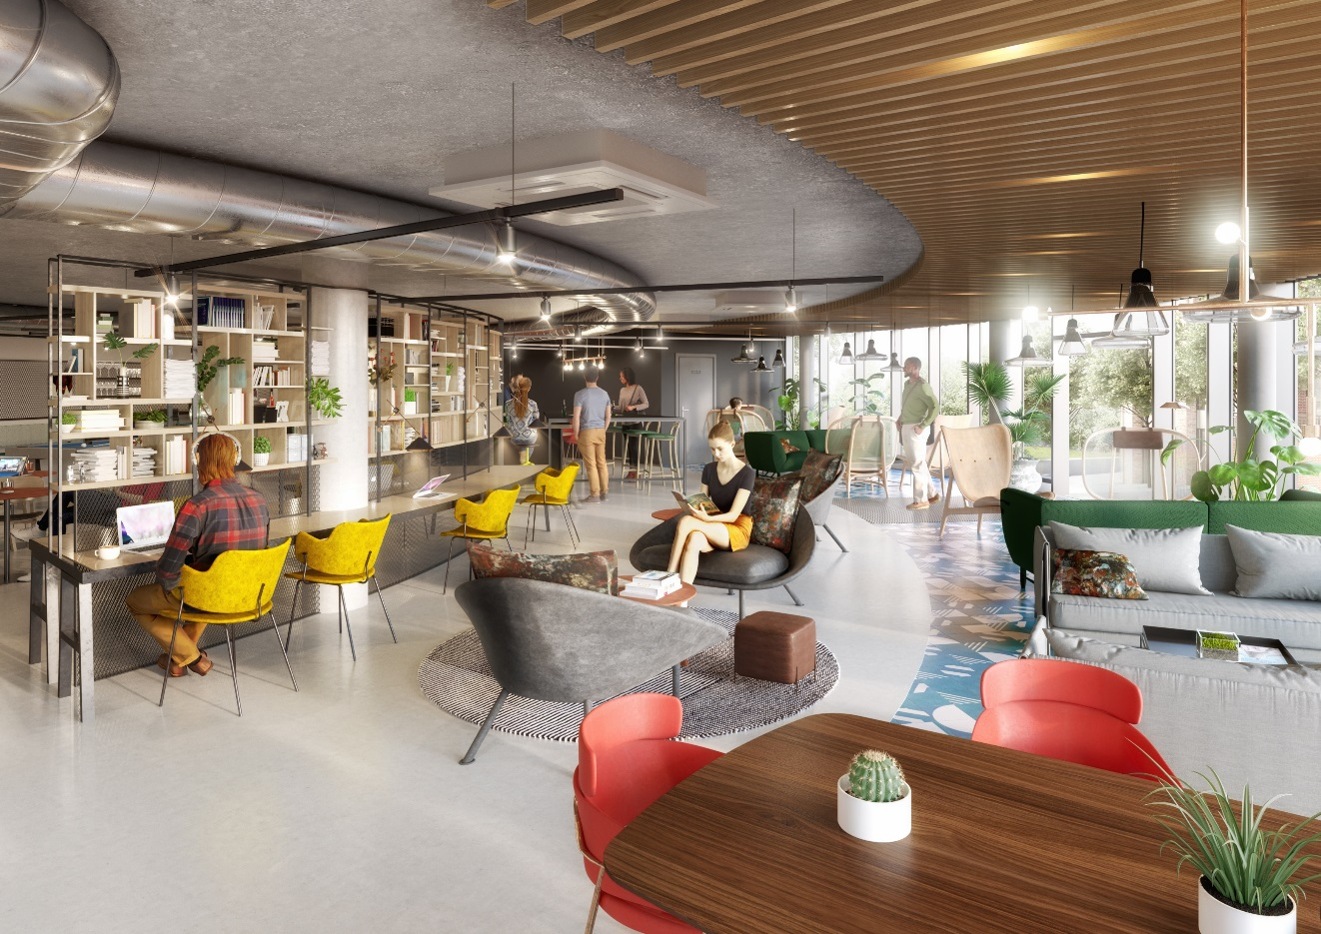
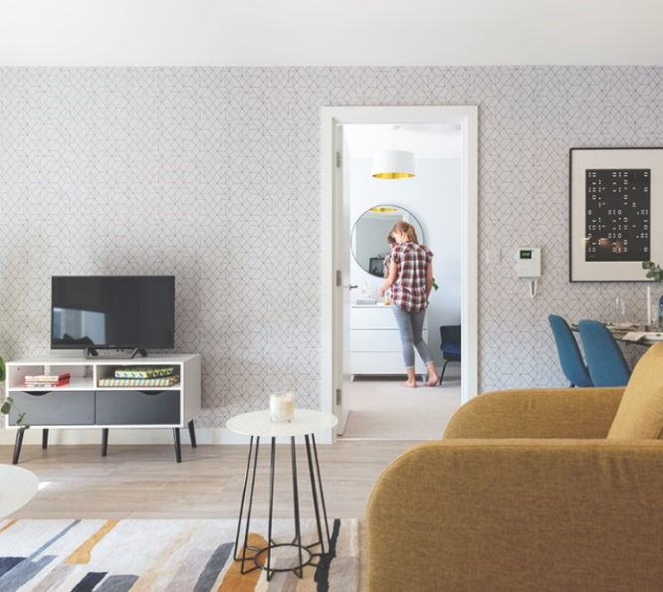
Case study
Clippers Quay, Salford Quays, Greater Manchester
Apartments | 614
Investment cost | £99m
Phase 1 Opening Oct. 2018

Slide 23
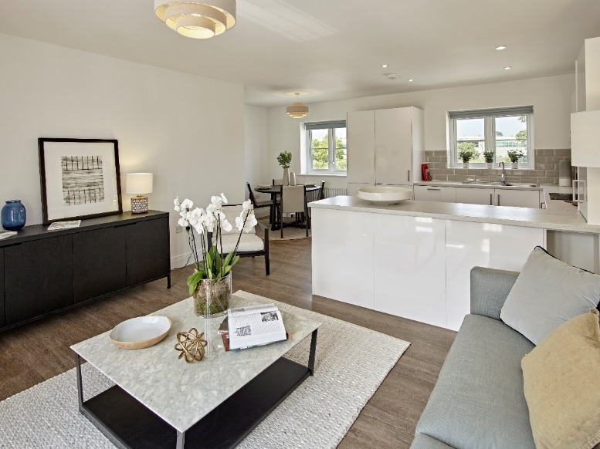

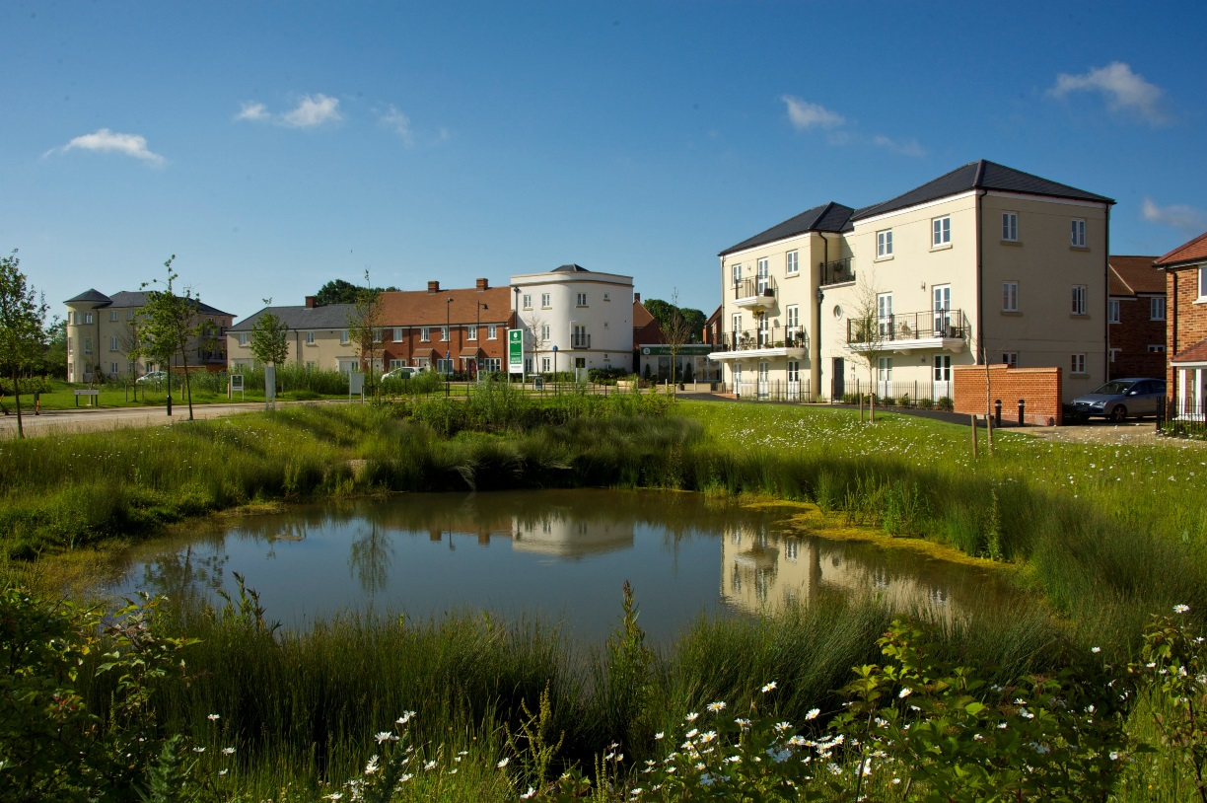
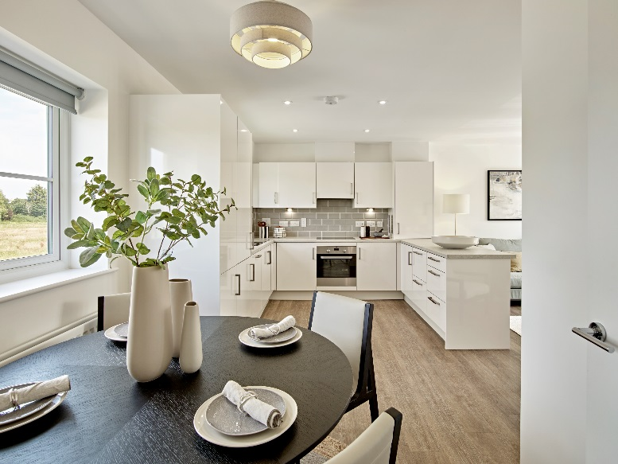
Case study
Berewood, Hampshire
Homes | 104
Complete | November ‘19

Slide 24
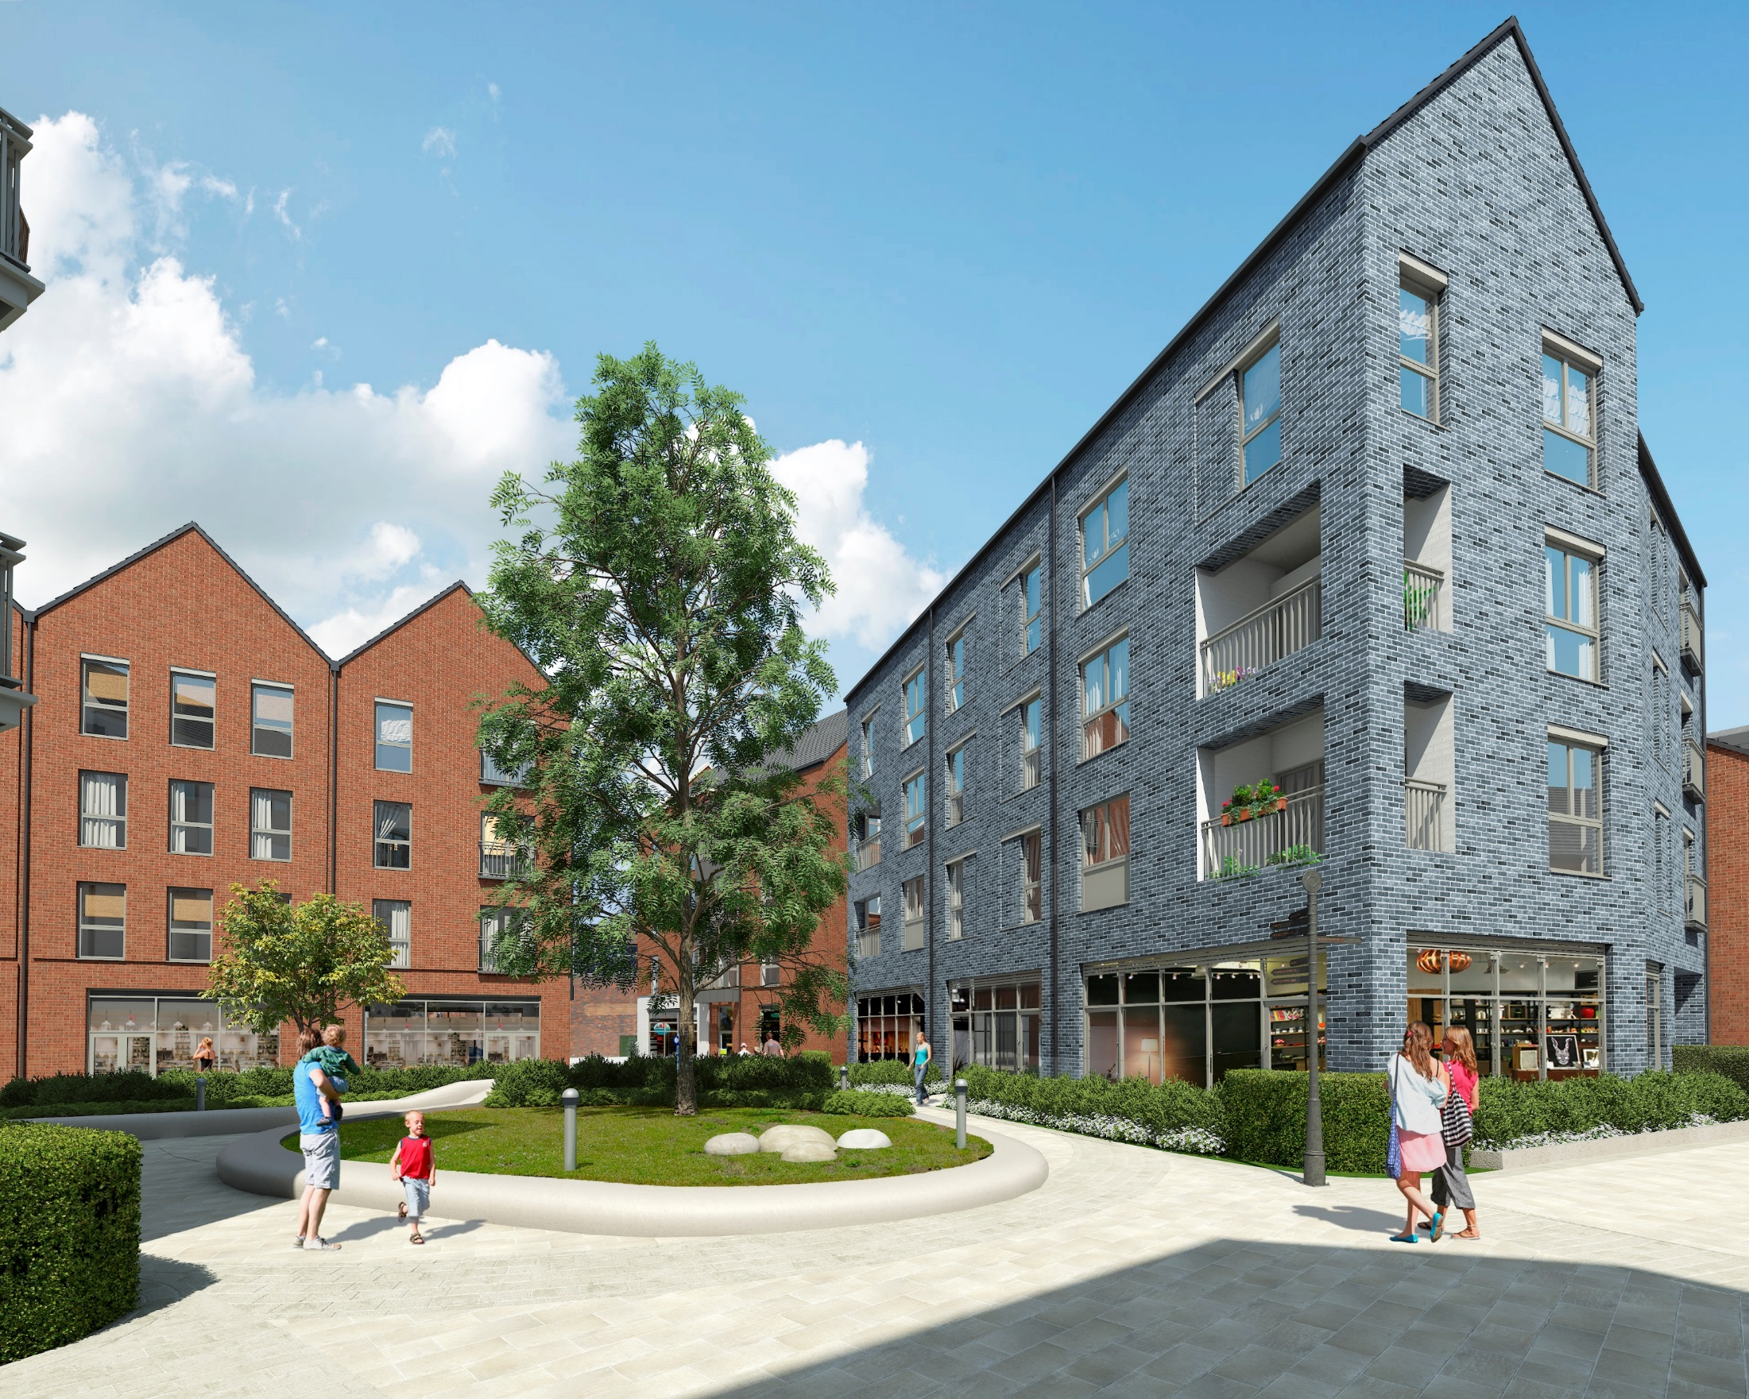
Thank you

