Slide 1
My Emotions
By Sophie Webster

Slide 2
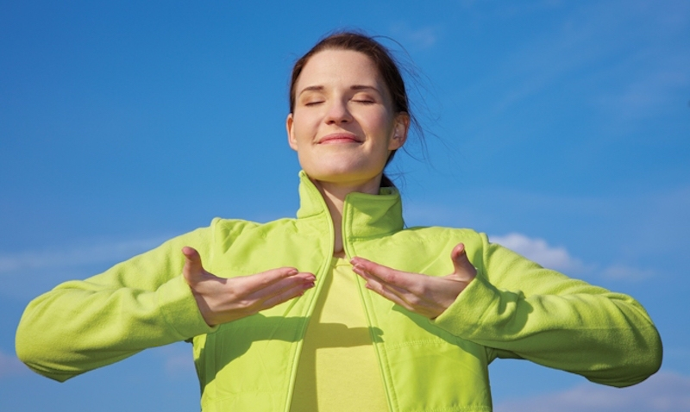
Breathing x3
Breathe in through the nose…hold for 3 seconds…and breathe out slowly and quietly through the mouth.

Slide 3
Ask permission to touch your partner

Slide 4
The Wave
We all have many different emotions inside of us.

Slide 5
The Fan
Sometimes, we will feel an emotion inside our head, tummy or throat.

Slide 6
The Sprinkle
Some emotions make us feel hot or cold, all over our bodies.

Slide 7
The Squeeze
Each emotion we feel inside of us has equal importance.

Slide 8
The Bounce
We will have days when we feel happy and excited.

Slide 9
The Drum
But we will also have days when we feel angry or sad. That is ok!

Slide 10
The Calm
We must remember that we can write, draw or tell someone how we are feeling.

Slide 11
The Wave
Because it is important to share our feelings no matter what emotion we have!

Slide 12
Say thank you to each other!

